Slide 1
Format – Long Form (1 of 2)
Executive Summary
Table of Contents
Introduction
Theory/Literature Review
Experimental Procedures/Apparatus
Results and Discussion
Conclusions and Recommendations

Slide 2
Format – Long Form (2 of 2)
Acknowledgements
Author Contributions (who did what)
References
Tables – if not embedded
Figures – if not embedded
Appendices
Data and Example Calculations
Nomenclature/Symbols

Slide 3
Format – Short Form
Omits
Theory/Literature Review
Table of Contents
Shortens Considerably
Introduction
Experimental Procedures/Apparatus
Do not neglect ‘lessons learned’

Slide 4
Format – Memo Form
Executive Summary
Quad Chart
Author Contributions
Example Calculations
Table of Equipment
Table of Utilities
PFD

Slide 5
Executive Summary
Short and to the point
Objective and motivation of your work
Major conclusions/recommendations clearly stated
Hard numbers to support your conclusion
Profitability
Capital costs
Major drivers/uncertainties
No Jargon, No unnecessary detail

Slide 6
Executive Summary - format
Title of report – centered
Text – 3-4 paragraphs
Submitted by: names and date

Slide 7
Introduction
Assumes the reader has not read the executive summary/abstract
Includes:
Objective of work
Scope of work
Background information

Slide 8
Theory/Literature Review Section
Review scientific literature on the topic
Explain the relationships used in your analysis – don’t go deeper than that unless you derive new theory
Highlight assumptions/simplifications
Avoid detailed derivations of equations
Give typical values for parameters

Slide 9
Theory - example
Limiting current for electroplating
No need for extensive lit. review, perhaps cite one textbook chapter on the subject
I_{limit} based on Fick’s and Faraday’s laws
Linear, one dimensional diffusion
Bulk is well mixed, constant concentration
D_{Cu++} ~10⁻⁶ cm²/s
At limit, surface concentration is zero
Boundary layer thickness from correlations

Slide 10
Theory – Fuel Cell Exp.
Don’t give detail on how fuel cell works
Do explain calculations of
Efficiency
Heat exchanger sizing
Compressor sizing, energy consumption

Slide 11
Theory – Distillation
Don’t give me the whole text book
Do explain efficiencies
How are they determined
Assumptions made

Slide 12
Experimental
Not as detailed as foreman’s report
Still includes a general outline of procedures followed and major pieces of equipment
Table of experimental conditions used
Include calibration information
How calibrated, what resulted
Lessons Learned in the Lab
What worked, what didn’t work

Slide 13
Results and Discussion
Think carefully about it
Each section should flow into the next logically
Data and analysis
Does data agree with theory?
Sources/magnitudes of error
Unusual results?
Scale up and Economic Evaluations
What are the major drivers?
Is there something that must be looked into before proceeding?
Conclusions/recommendations are stated here, with the supporting evidence

Slide 14
Results and Discussion
Use Figures to show trends in your results
A picture is worth a thousand words
Block Diagrams or Process Flow Diagrams
Always need one or the other
Tables of Equipment/Utilities
Summarize in one place
Cost, size, key parameters, energy/utilities used
Linked to PFD

Slide 15
Conclusion and Recommendations
Bulleted listing
Repeats what’s in Discussion
Don’t spring something new or unsupported on the reader here!
Don’t forget minor items
Suggestions for improved procedures/analysis, more data needed, different equipment – anything needed to minimize uncertainty
If there’s no doubt about the conclusion – say so.

Slide 16
Figures/Graphs
Not more than two to a page
After text is fine, embedded ok
Don’t blindly go with Excel’s defaults
Scaling, use of major/minor tick marks
Significant figures, axis labels
Avoid color – likely to be photocopied
Marker size and line width

Slide 17
Calculations / Data
Appendix contains
Example calculations
By hand(?), with units shown
Correct significant figures shown
With references to cells for Excel spreadsheets
Excel files
Include the file with email submission
Aspen
Attach appropriate reports or *.bkp file

Slide 18
Calculations / Data
Don’t assume I will dig into Excel to find everything that you did.
I grade the report
I look in Excel to check accuracy – not to find additional points for your score

Slide 19
Costing
Equipment costs: Aspen or Guthrie charts
Capital cost only
Do not include: installation, instrumentation labor, site prep, taxes, depreciation
(Lang factors)
Do include cost factors for materials, e.g.
Corrosion – steel, stainless steel, Ti, Monel
Pressure – generally above 100 psig
Do include Cost Index

Slide 20
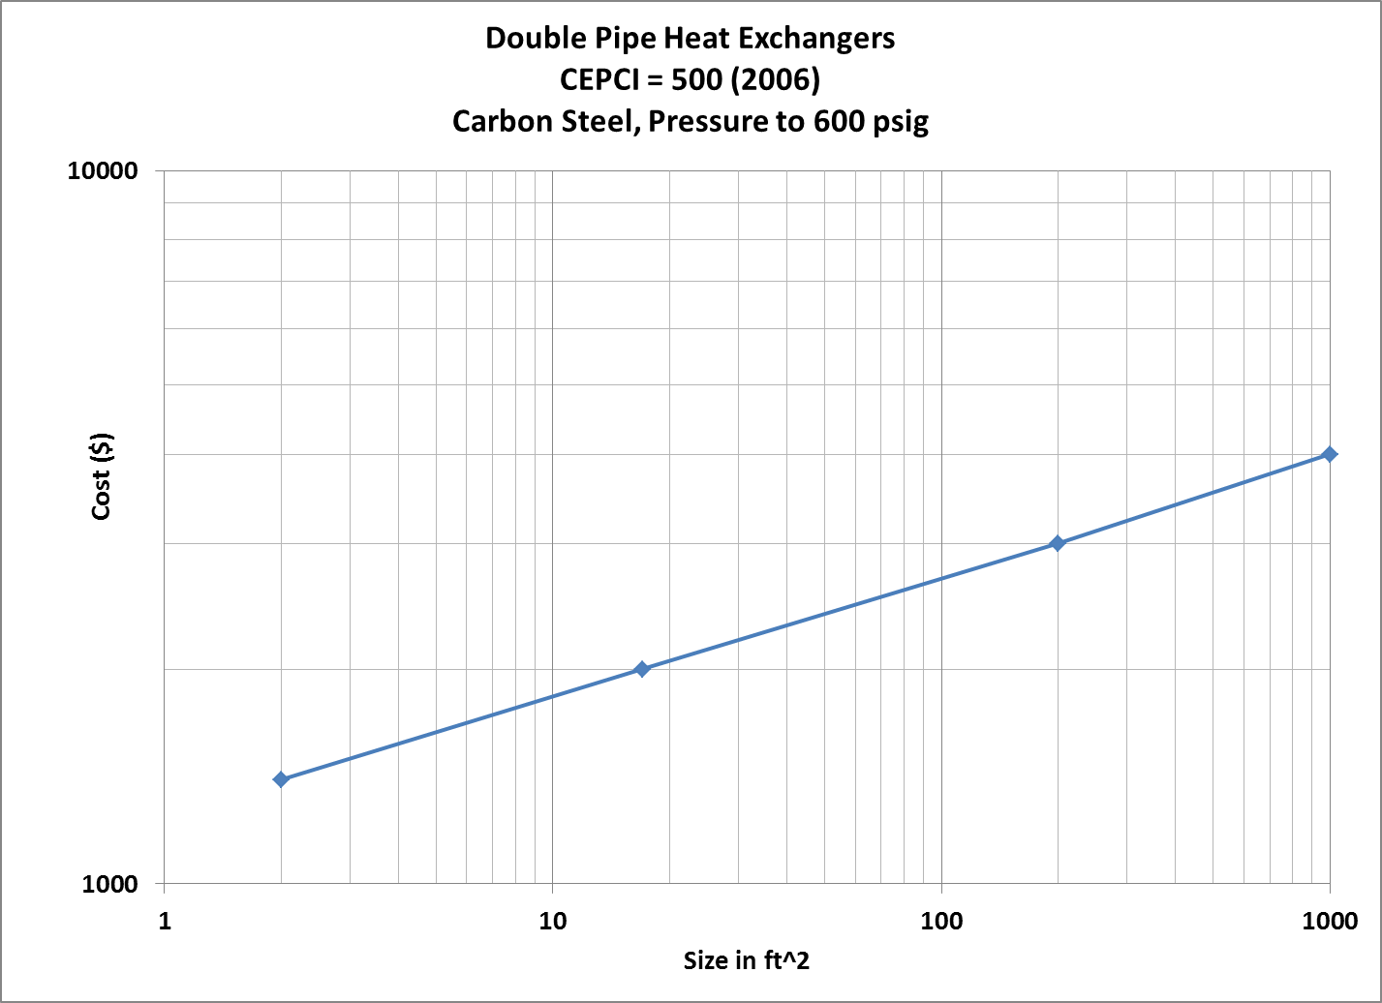
Costing – Guthrie example
Chart gives base cost (Cb)
Material Factor – Fm
=1 for carbon steel (cs)
=2 for cs/stainless steel
=3 for SS/SS
Pressure Factor – Fp
= 0.85 + 0.13(P/600)
Purchase Cost = (Cb)(Fm)(Fp)
Cost Index = 500 (2006)
Cost Index = 585.7 (2011)
Cost = purchase cost *(585.7/500)

Slide 21
Record Keeping
Industry – Data and Records
Data found in Lab Notebook #XXX, p. yy-zz
Reference Patent application or Disclosure if relevant

Slide 22
Report Basics
1” Margins
single line spacing
12 pt. font
single sided
Significant Figures and Units
In text, tables and figures
Watch page limits

Slide 23
See Style Guide for…
Format for references
Format for section numbers, T of C
How to handle equations
Grammar for technical reports
Avoid personal pronouns (I, we, etc)
Past/present tense
No slang
Leading zeros 0.12 = yes, .12 = No

